Slide 1

Customer Shopping Behavior Analysis
3,900-row dataset — 18 columns. Goal: uncover spending patterns, segments, product & subscription behavior.

Slide 2

Dataset Summary
Dimensions
Key Types
Important Columns
Rows: 3,900 · Columns: 18
Numerical, Categorical, Date/Time
CustomerID, Age, Income, Spending Score, Category, Purchase Amount, Payment, Date

Slide 3

Exploratory Data Analysis (Python)
Import & Inspect
pd.read_csv → df.info() · df.describe()
Preview
Checked head() — sample rows include demographics, items, amount, rating, subscription
Missing Values
Review Rating: 37 nulls → imputed with category median
Cleanup
Dropped redundant promo_code_used (duplicate of discount_applied)

Slide 4

Database Integration
Load to PostgreSQL
Used sqlalchemy + psycopg2 · df.to_sql('customer', engine, if_exists='replace')
Result: Data successfully loaded into 'customer' table

Slide 5
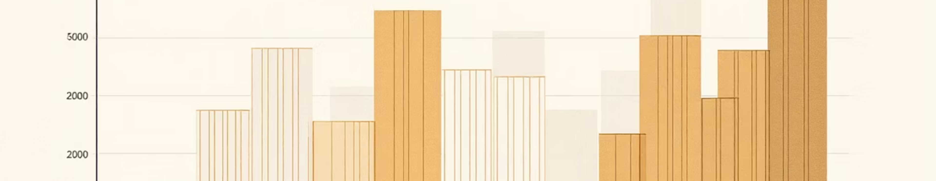
Revenue by Gender
Female
Male
Revenue: 75,191
Revenue: 157,890

Slide 6


Discount & High-Spend Users
Identified customers who used discounts yet spent above average. Examples: purchases 64, 73, 90, 85, 97...
High-Spend + Discount
Examples
Multiple customers spent > average while using discounts.
Purchase amounts: 64,73,90,85,97,68,72,81,90,62

Slide 7



Top Products & Discount Dependence
Highest Discount Rates
Hat — 50%
Sneakers — 49%
Coat — 49%
Sweater — 48%
Pants — 47%
Gloves
Sandals
Boots
Avg rating 3.86
Avg rating 3.84
Avg rating 3.82

Slide 8

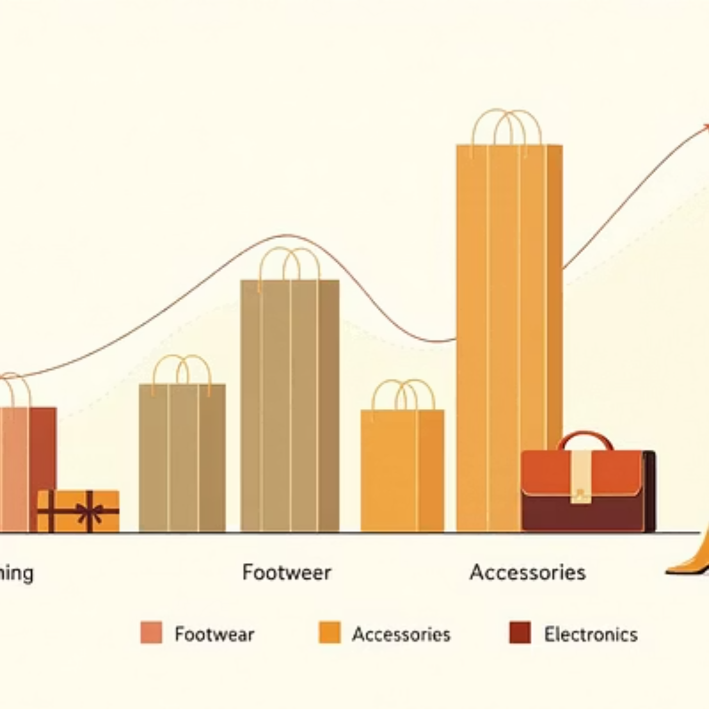
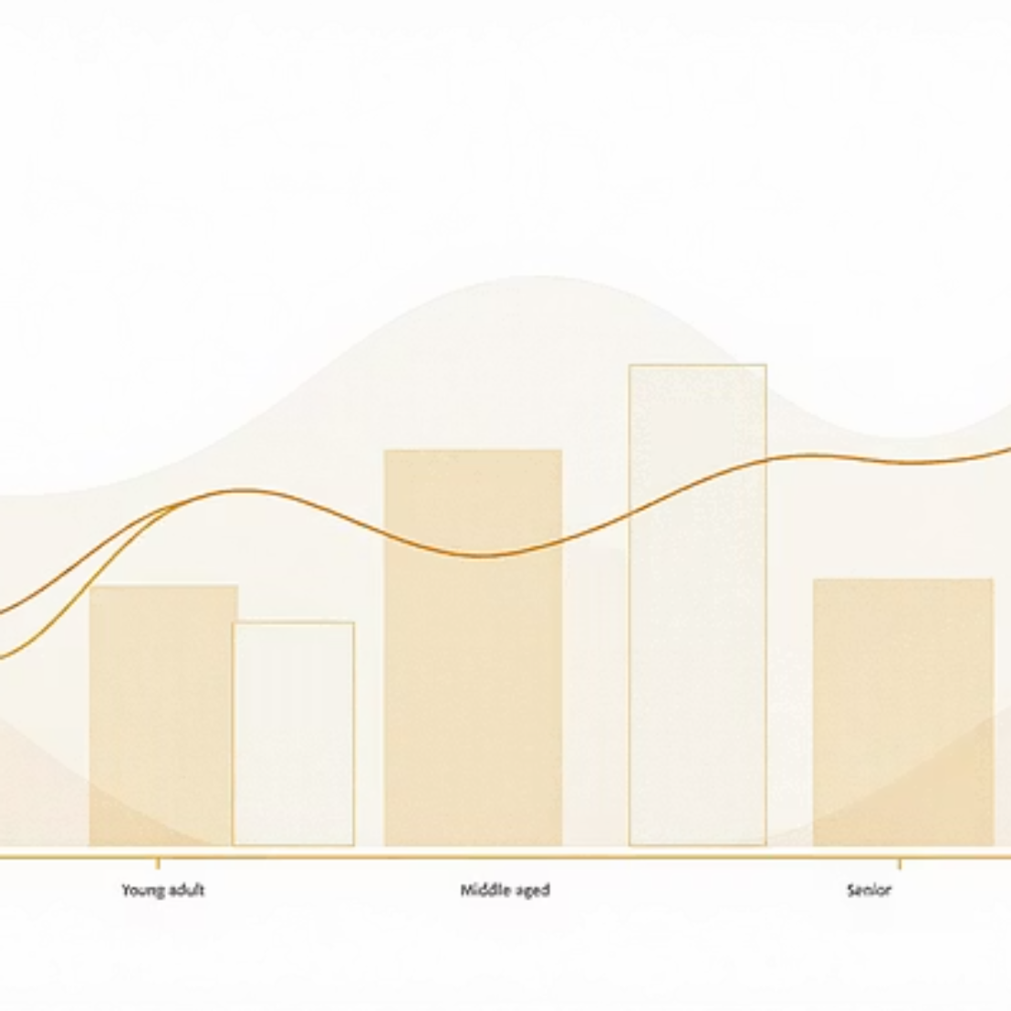
Power BI Dashboard
Interactive dashboard: 3.9K customers · $59.76 avg purchase · 3.75 avg rating

Slide 9
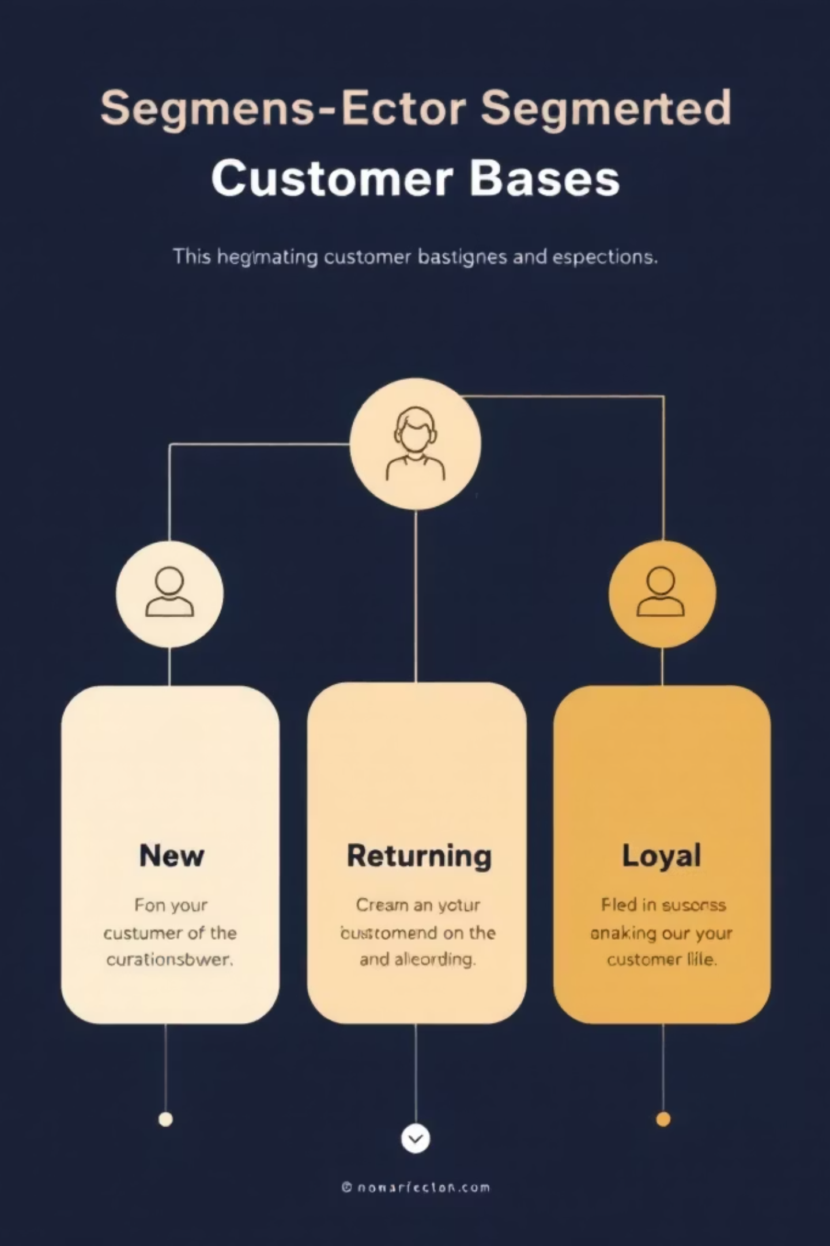

Segmentation & Subscriptions
Loyal
3,116 customers
New
83 customers
Returning
701 customers
Subscribers vs Non: Yes=1,053 (avg spend 59.49, revenue 62,645) · No=2,847 (avg 59.87, revenue 170,436)

Slide 10
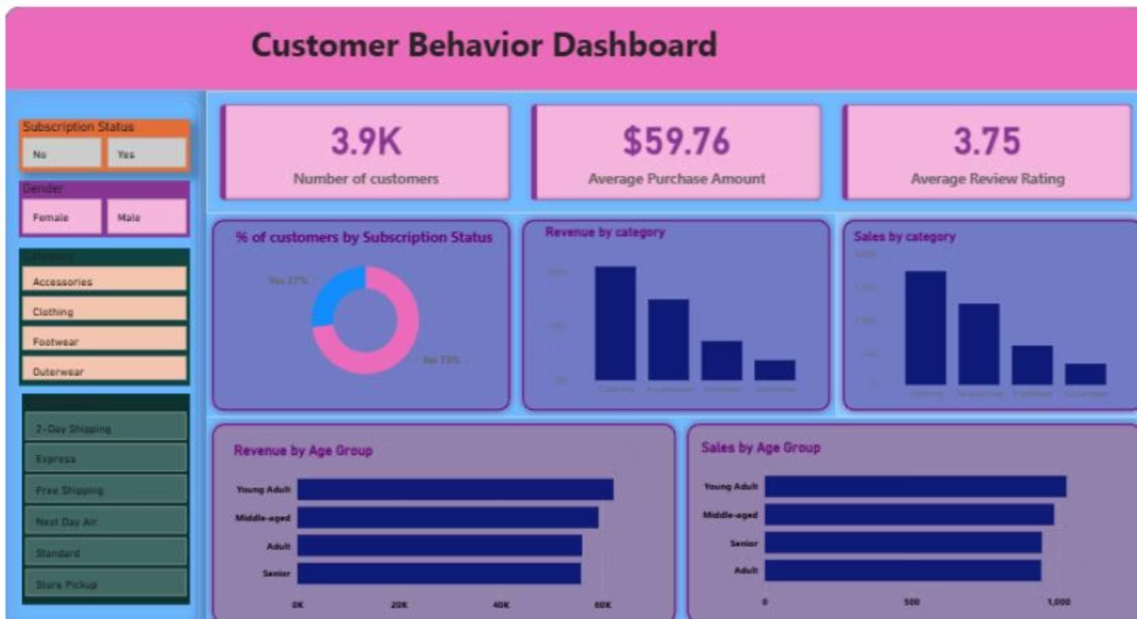
Business Recommendations
Boost Subscriptions
Loyalty Programs
Review Discounts
Product Positioning
Promote exclusive subscriber benefits
Reward repeat buyers to increase loyalty
Balance promotions with margin control
Highlight top-rated & best-selling items
Targeted Marketing
Focus on high-revenue age groups & express-shipping users

